Slide 1
Munich Public Schools
Public Meeting
Sept. 14, 2021

Slide 2
What is the Purpose of this meeting?
North Dakota Century Code Chapter 57-15-02.2 states
“On or before August tenth of each year the governing body of a taxing district shall provide to the county auditor in each county in which the taxing district has taxable property a preliminary budget statement and the date, time, and location of the taxing district's public hearing on its property tax levy, which may be no earlier than September seventh”.
The Purpose of this public hearing is to allow tax payers to give their input as to the taxes which are being considered.

Slide 3
Background of Munich Property Taxes

Slide 4
Compare 2020-2021 to 2021-2022

Slide 5
Past and Current Spending

Slide 6
Deficit Spending and Percent Carry-Over

Slide 7
State Law and percentage carry over.
North Dakota Century code states that a school may carry- over 35% of General Fund expenditures + $50,000.
A 30% carry-over is what I strive for. We finally met that goal after last year. (2020-2021)

Slide 8
Mills Allowed vs. Milled Levied

Slide 9
Munich Public Schools is Levying $285,120 less than the legal limit.
This number includes possible Levies on Building Fund. If that is taken out of the equation, Munich Public Schools is levying $206,430 less for general education expenses as allowed by law.

Slide 10
How do we compare?
Based on last year’s data:
Of Schools with a PK Population of between 19 and 100, Munich ranks 5th out of 16 for total Mill Levy and
8th out 16 for cost per pupil.

Slide 11
Last Year’s Data

Slide 12
What does this mean for me?

Slide 13
Transition Minimums
One of the issues we will be facing for the next six years is the issue of transition Minimums.
In the 2013 legislative session, a bill was based known as the property tax reduction bill, which limited the amount of mills many local entities, including schools, could levy.
For many schools, the state recognized that this reduction could not be “made up” with the new funding formula they had created.
As a result, a line was added to the new formula known as the transition minimum, which gave these schools extra funds.
This “transition minimum” was meant to “transition” schools to the new formula. This process has begun.

Slide 14
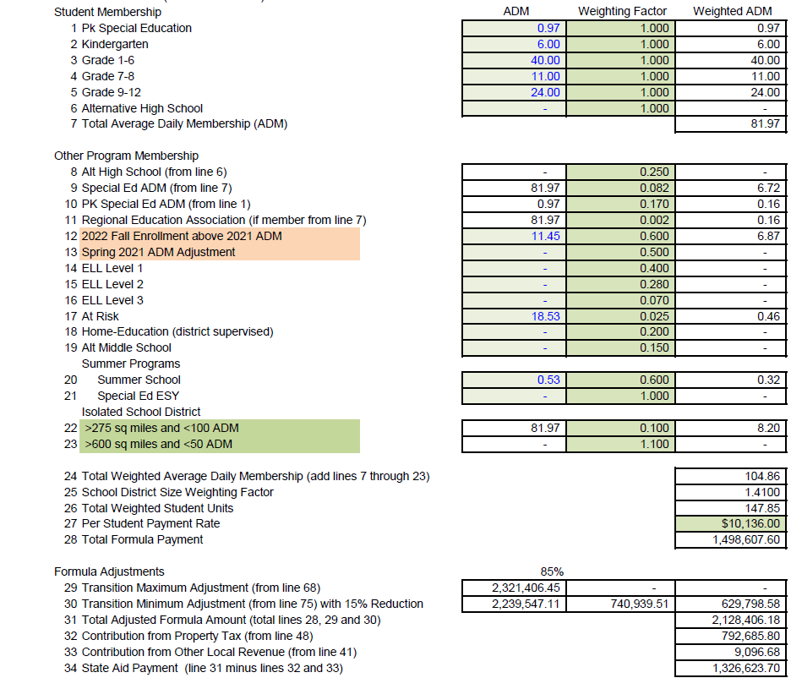

Slide 15
2020-2021 Funding

Slide 16
2021-2022 Funding

Slide 17
Affect of Transition minimums on our funding

Slide 18
Conclusion
As a school district, Munich Public Schools is in sound fiscal shape in that there is plenty of room for growing revenue if necessary. That is increasing taxes. That being said, it is the intent of administration and the school board to provide the highest quality education possible while keeping expenses down. There are always methods to reduce spending from not engaging in certain building improvement projects to cutting services (including teachers) however, at this time, after a review of our taxes and spending, I believe that for a school our size we are providing a quality education at a reasonable cost to our taxpayers.
Questions???

